Slide 1

National Institute of Technology Delhi
End Semester Presentation
Machine Learning for Resource classification on the basis of user role

Slide 2
Presented By
Harsimran Bhasin
B.Tech (CSE)
131100021
Yash Phogat
B.Tech (CSE)
131100063
&
Under the guidance and support of
Ms. Akanksha Juneja

Slide 3

Early Days / Present Days
Resource Administrator
Employees

Slide 4

Our Aim for Future
Resources allocated automatically

Slide 5
Problem Statement
The aim of the project is to design a classifier that can classify whether a resource(file) can be accessed by a particular employee role.
Using the training data of employee roles and their provisioned access, models can be built that automatically determine access privileges as employees may enter or leave roles within a company. These auto-access models seek to minimize the human involvement required to grant or revoke employee access.

Slide 6

Information Extracted On Data Digging
PROBLEM 1.) There are two files of data:
Train.csv – Sample Count 32769
Test.csv -- Sample Count 58922
In the train set there are 30872 instances in class 1 (Majority Class) and 1897 instances in class 0 (Minority Class)

Slide 7
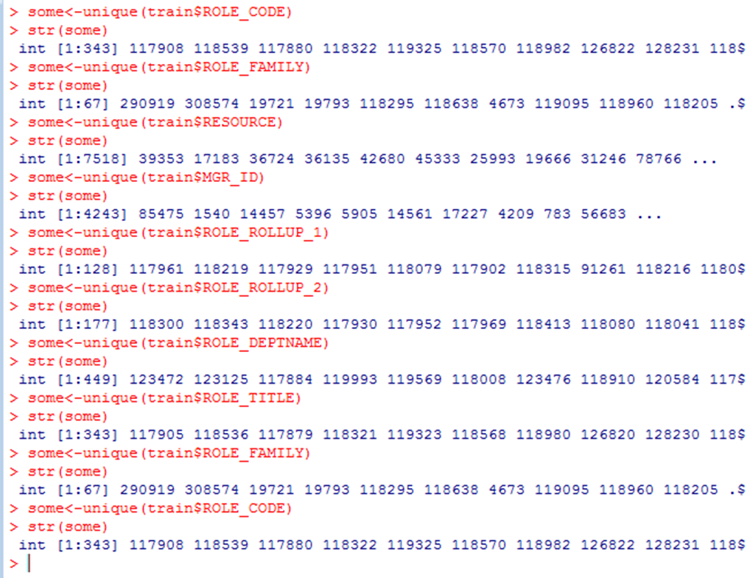
Information Extracted On Data Digging
Problem 2.) The type of every feature is categorical, but there are large number of categories for each feature:

Slide 8
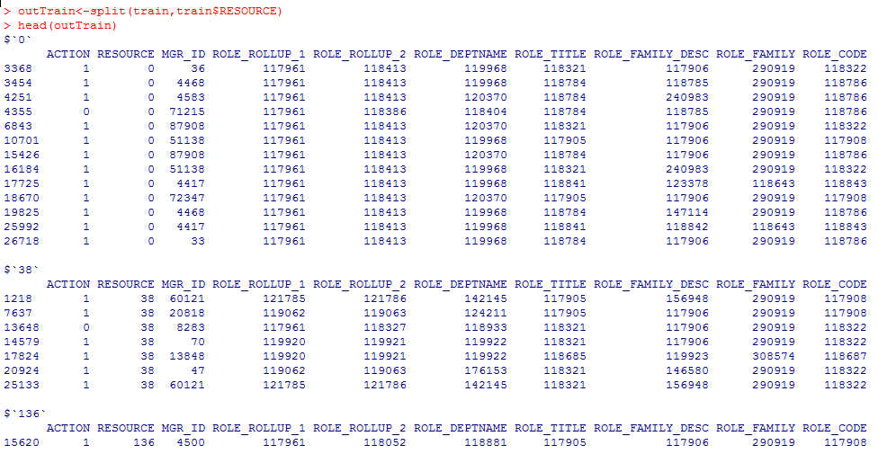
Information Extracted On Data Digging
3.) There are 7518 unique resources each having one or more instances of employee role.

Slide 9
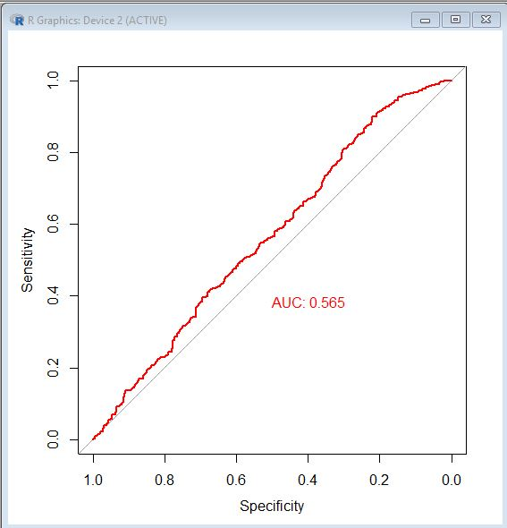
Evaluation Metric
Area Under Receiver Operating Characteristics (ROC) curve
Displays the performance of
the method for any choice of
threshold.
TP rate = 1-FN rate
The area under the curve (AUC) measures the quality of the classifier:
0.5 is the AUC for a random classifier
The closer AUC is to 1, the better

Slide 10
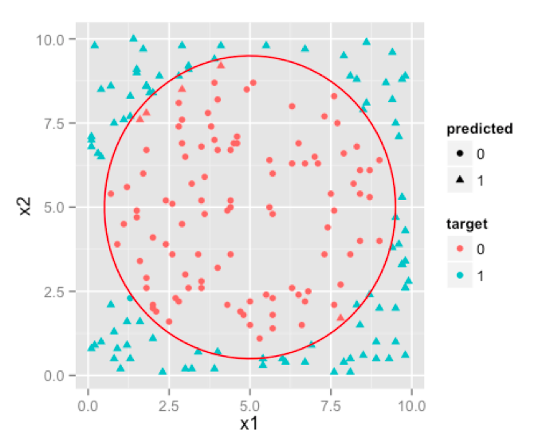
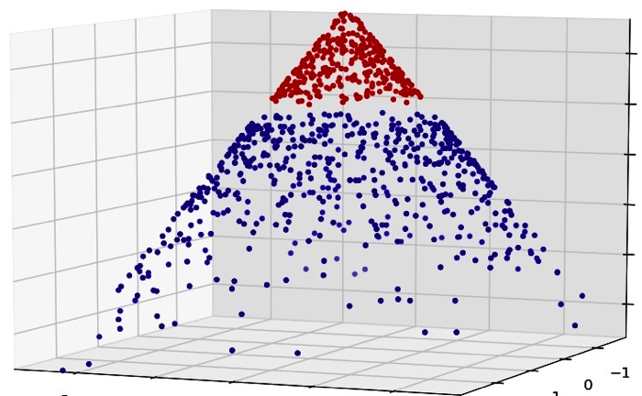
Prediction Model Used: Support Vector Machine Classification
Motivation
While researching about the problem , we realized an analogy of the problem with the allocation of resources over a cloud system. The Cloud has to continuously make decisions about resource allocation on time and performance factors etc. A research paper suggested doing this by Machine Learning by using Support Vector Regression.
SVM

Slide 11
Introduction of Weights in Data
A major problem in our dataset was Data inconsistency i.e. presence of huge data of class “1” (94%) but very less data of class “0” (6%).
SVM
To solve this problem we needed to assign weights to the classes accordingly. This led us to obtain normalized data for SVM classification resulting to a significant increase in the accuracy of classification.

Slide 12
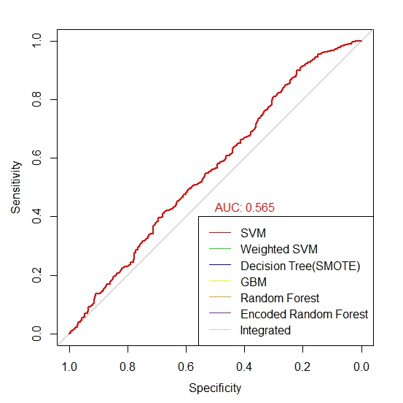
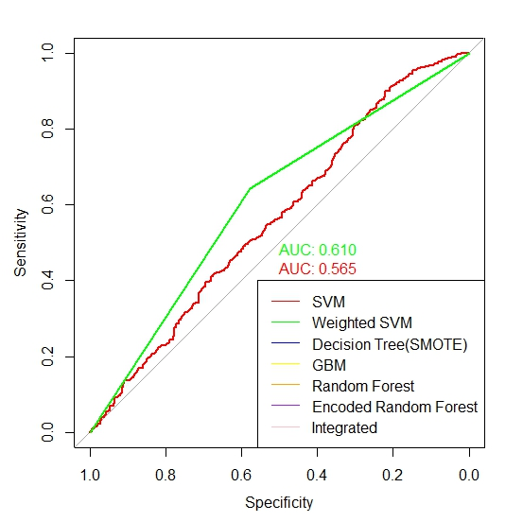
Receiver Operating Characteristics Curve
Simple SVM (without class weights)
Weighted SVM

Slide 13
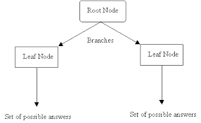
DECISION TREE
In Decision Tree classification we used the SMOTE(Synthetic Minority Oversampling Technique) utility to balance our sample train set.
On running the Decision Tree algorithm (rpart) we obtained an accuracy similar to the SVM model.
A decision tree

Slide 14
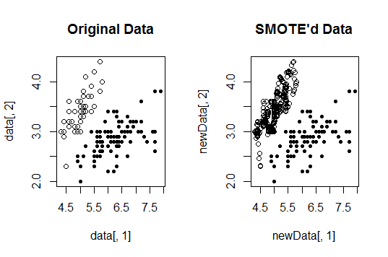
SMOTE: Synthetic Minority Over-sampling Technique
The basic algorithm of SMOTE is that for each minority class instance (i.e. 0), we generate a synthetic instance from some of the k nearest neighbors of the original instance. This process can be interpreted as choosing a random point in the line between two feature vectors as our new samples

Slide 15
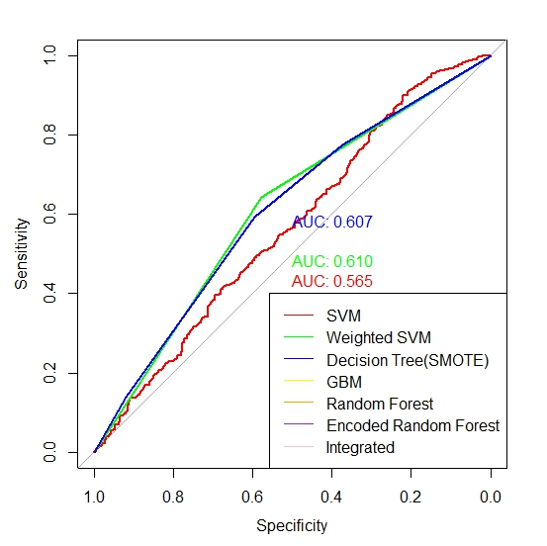
ROC curve for Decision Tree with SMOTE

Slide 16
Further to increase the accuracy of classification, we moved over to feature extraction.
In feature extraction we tried to identify the features that contribute the most in classification.
This may help by avoiding the features that doesn’t contribute to classification accuracy, and rather deteriorate it.
Feature Extraction

Slide 17
The contribution of each feature in the classification is shown in the following table:
Feature | Contribution In Classification (%)
RESOURCE | 5.808
MGR_ID | 8.09
ROLE_ROLLUP_1 | 8.5
ROLE_ROLLUP_2 | 5.82
DEPTNAME | 7.14
ROLE_TITLE | 5.45
ROLE_FAMILY_DESC | 5.45
ROLE_FAMILY | 5.4
ROLE_CODE | 6.1
Here we see that all the features have very small amount of individual contribution to classification accuracy, so feature selection and extraction for SVM algorithm seems futile.

Slide 18
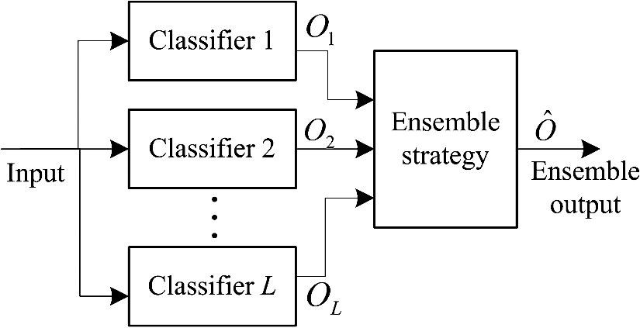
Ensemble Models

Slide 19
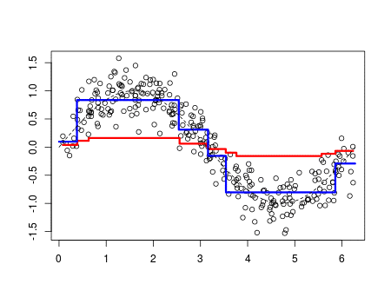
GBM involves 3 components.
Loss Function: A function to measure the relative loss of accuracy for every weak learner model we learn on various samples. E.g.: Squared error, logarithmic loss.
Weak Learner: The learner algorithm that gives a dim accuracy on its respective sample. We iteratively attempt to identify better learners, to obtain an integrated strong learner. Typically uses Decision Trees as the weak learner.
Additive Model: Weak learners are added one at a time, and the previous existing learners in the model are not modified.
Weights are assigned to every primitive weak learner in every iteration, to finally obtain a strong learner. Analogous to Neural Networks.
Gradient Boosting Machine

Slide 20
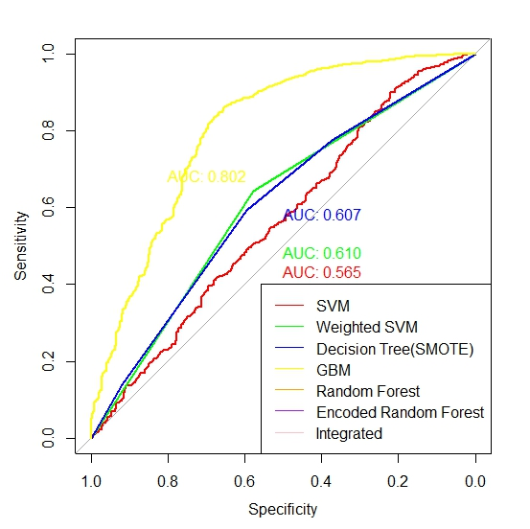
Receiver Operating Characteristics (ROC) curve for Gradient Boosting Machine (GBM)

Slide 21
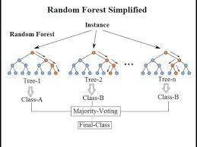
Random Forest
Random Forest - Most powerful ensemble learning algorithm
Works on the principle of bagging.
Random samples of the data are chosen and there is random selection of features as well.
Then a decision tree is constructed on this random sample set.
Similarly large number of trees are created in the random forest algorithm.
For every instance the predicted class label of the majority of the trees is considered as the relevant class label.
Random Forest

Slide 22
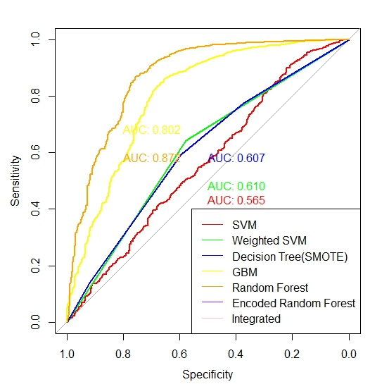
Receiver Operating Characteristics (ROC) curve for Random Forest.

Slide 23
Mapping Large No. of Categories into Unique Values - One Hot Encoding
A further optimization has been made by creating one-hot encoded data of the feature categories.
Categorical variables are intentionally encoded as numerical variables in order to be used as features in any given model.
e.g. [London, US, India] becomes [10211, 10212, 10213].
This imparts an ordinal property to the variable, i.e. London< US< India that is usually not desired.
One hot encoding is necessary for the proper representation of the distinct elements of the variable.
S.No | Category Data | One Hot Encoded Data
1 | 118322 | 001
2 | 118321 | 010
3 | 112565 | 100

Slide 24
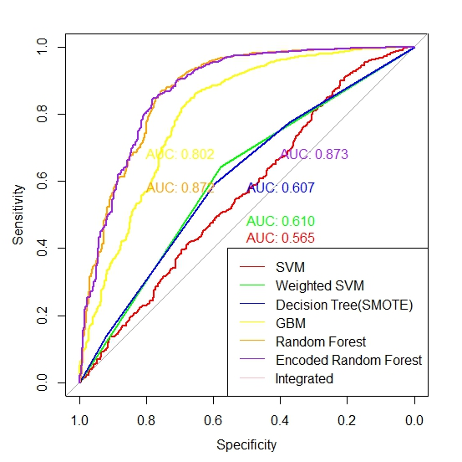
Receiver Operating Characteristics (ROC) curve for Random Forest with One Hot Encoding.

Slide 25

Best Classifier’s Integration
We tried integration of our best classifiers in every permutation to achieve the best results.
Finally we integrated the results of our two best learners i.e. Random Forest and One Hot Encoded Random Forest.
For this we simply multiplied their predictions with their respective AUC values and then divided by the sum of those AUC’s.
This gave us the final accuracy for our model as 88.5 % .

Slide 26
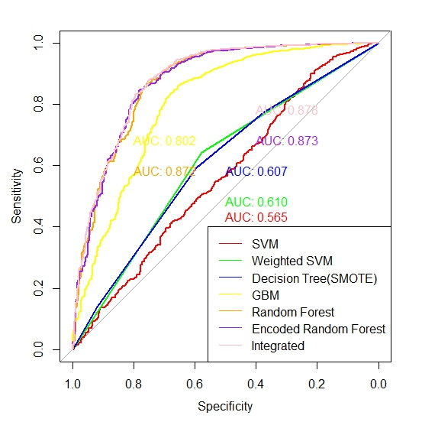
Receiver Operating Characteristics (ROC) curve for Integration of Random Forest and Encoded Random Forest.

Slide 27
Thank You

